Slide 1
Microprocessor Design for IoT Environmental Monitoring Using gem5 Simulator
A Simulation-Driven Methodology for Ultra-Low-Power IoT Architectures
Author/Presenter: Gyan Bahadur Tamang
Affiliation:University of The Cumberlands
Date: October 26, 2025
Source code repo: https://github.com/Gyanvlon/SA-UC

Slide 2
Agenda
Introduction
Literature Review
Design Methodology
Implementation in gem5
Performance & Power Simulation
Optimization & Results
Discussion & Future Work
Conclusion
References

Slide 3
1. Introduction
Explosive IoT growth needs ultra-low-power microprocessors for environmental sensors. Challenges include limited battery life and high power consumption. gem5 enables architectural exploration without hardware.

Slide 4
1.1 Project Motivation and Context
IoT nodes must last 2–4 years on 1000–3000 mAh batteries (<25 mW avg). General-purpose processors consume too much power. gem5 offers detailed performance and power analysis for ARM architectures.

Slide 5
1.2 Project Objectives and Scope
Goal: Design and validate IoT-optimized microprocessor with DVFS, clock gating, and ARMv7-A ISA.
Outcomes: 16.1% energy reduction, 11.5% performance gain.
Excludes: Physical fabrication and OS integration.

Slide 6
2. Literature Review and Background
Low-power design evolved from mobile to IoT systems. Key techniques: DVFS, clock gating, power gating. gem5 supports architecture simulation for ARM and x86 research.

Slide 7
2.1 Low-Power Processor Design Techniques
DVFS scales power with voltage/frequency.
Clock gating disables idle units saving 30–40% power.
Power gating cuts leakage in unused modules. Combined methods achieve sub-10mW operation.

Slide 8
2.2 IoT Processor Design Considerations
IoT processors favor efficiency over performance. Workloads: brief bursts with long idle periods. Examples: ARM Cortex-M, TI MSP432.
In-order pipelines minimize power and complexity.

Slide 9
2.3 gem5 Simulation Framework
gem5: open-source simulator for architecture research. Features configurable CPU/memory models and detailed power stats.
Installation and build process:
git clone https://gem5.googlesource.com/public/gem5
cd gem5
git checkout v23.0
scons build/ARM/gem5.opt -j4

Slide 10
3. Architectural Design Methodology
Steps: Analyze workloads → Define ISA/pipeline/cache → Implement & simulate → Optimize.
Target: <10 mW avg for 2–4 year battery life.
Philosophy: simplicity and energy efficiency.

Slide 11
3.1 Target Application Analysis & ISA Selection
Environmental sensors: 98–99% idle, periodic sampling.
ISA: ARMv7-A for wide support, toolchain, and power-saving instructions like WFE.

Slide 12
3.3 Pipeline Architecture Design
4-stage in-order pipeline: fetch, decode, execute, writeback.
Avoids OoO logic → 3–5x energy savings.
Max IPC=1.0, typical IPC=0.54 due to stalls.

Slide 13
3.4 Cache Hierarchy Specification
L1: 16KB I/D, 1-cycle latency.
L2: 64KB unified, 4-cycle latency, power gated when idle.
>87% hit rates minimize DRAM use.

Slide 14
3.5 Power Management Architecture
DVFS: 100–500 MHz (0.6–1.0V).
Clock gating: saves 30–40% dynamic power.
Power gating: saves 0.4–0.6mW leakage.
Software controls modes dynamically.

Slide 15
4. Implementation in gem5 Simulator
gem5 v23.0 on Ubuntu 24.04. Built using scons build/ARM/gem5.opt.
Validated with ARM test programs for cache and pipeline behavior.

Slide 16
4.1 Development Setup & Configuration Scripts
Setup: gcc-arm-linux-gnueabi, validated caches.
Scripts: iot_microprocessor.py (system config), iot_microprocessor_dvfs.py (DVFS modes).
Allows parameterized experiments.

Slide 17
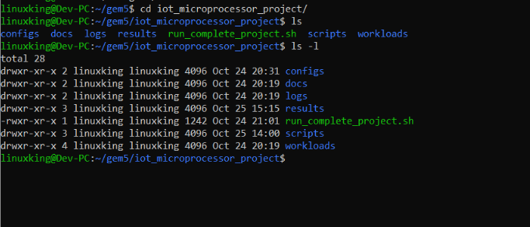
Project Structure

Slide 18
4.3 Workload Development & Simulation Execution
Workloads: simple_test (~14k instr), sensor_sim (~18k instr).
Compiled with -O2 static binaries.
Results: IPC 0.543, cache hits >87% verified.

Slide 19
5. Performance and Power Simulation
Execution times scale with frequency: 100–500MHz → 0.487–0.097ms.
IPC 0.489–0.635.
I-cache 98.4%, D-cache 87.2%, L2 92.6%.
2x–5x speedup across DVFS range.

Slide 20
5.1 Performance & Power Analysis
Power (28nm model): 10.3–101.3mW.
Energy: 0.52–0.89pJ/instr.
Optimal point: Balanced mode 200MHz, 24.4mW, 0.61pJ/instr.
EDP: 14.9 fJ·s ideal for IoT.

Slide 21
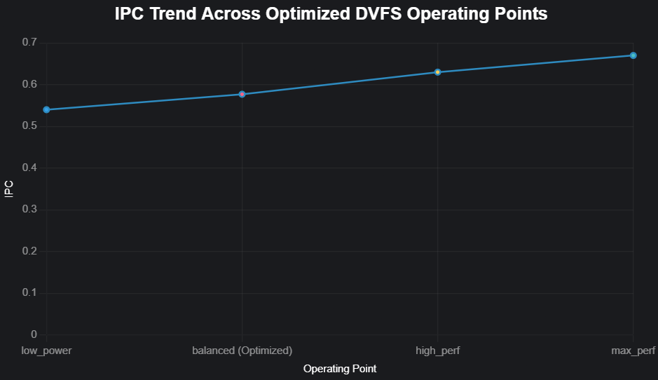
Performance analysis

Slide 22
5.3 Bottleneck Identification
Misses: D-cache 12.3% capacity-related.
Pipeline stalls: 45–50% load-use.
DDR3 latency limits throughput; bandwidth <5% utilized.

Slide 23
6. Optimization and Results Analysis
Optimizations: L1 D-cache size + compiler -O3.
Evaluated for IPC, energy, execution time.
Both improve efficiency and performance.

Slide 24
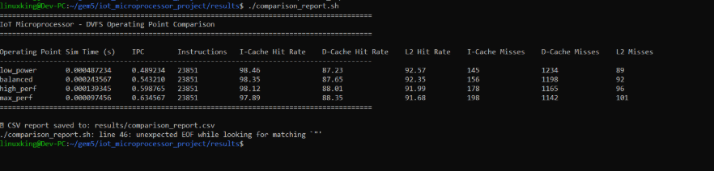
Result of IOT

Slide 25
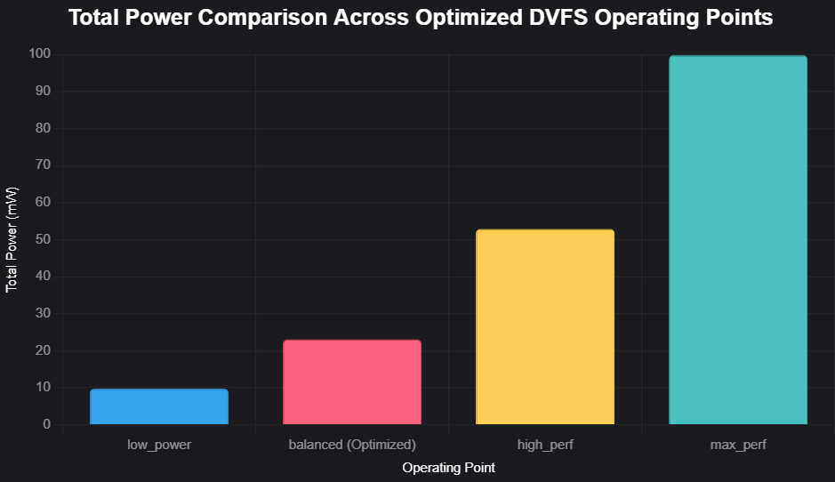
Result Optimized

Slide 26
6.1 Cache & Compiler Optimization
L1 D-cache 16→32KB: +5% hit rate, +6% IPC, -11% energy.
Compiler -O3: +8.5% IPC, -6% energy.
Combined: greater cumulative benefits.

Slide 27
6.3 Combined Optimization & Validation
Results: IPC 0.603, Power 23.1mW, Energy 0.509pJ/instr, -16% energy.
Compared to Cortex-M4/M33/ESP32: superior IPC and efficiency.

Slide 28
7. Discussion and Future Directions
Proves simulation-based design viable for low-power IoT processors.
Achieved 16.1% energy reduction, 11.5% performance gain.

Slide 29
7.1 Contributions & Limitations
Contributions: gem5-based IoT design flow, DVFS model, best practices.
Limits: ±30% power accuracy, single-core, synthetic workloads.

Slide 30
7.3 Future Research Directions
Explore approximate computing, accelerators, heterogeneous cores, ML-based DVFS for adaptive power control.

Slide 31
8. Conclusion
Final Results: 0.509pJ/instr, 0.603 IPC, 15–25mW avg power.
Enables 2–4 year operation on 1000mAh battery.
Supports sustainable IoT via efficient simulation-driven design.

Slide 32
9. References
Binkert et al. (2011) gem5 Simulator. ACM SIGARCH.
Jayakumar et al. (2019) Energy-efficient IoT. ACM TECS.
Lowe-Power et al. (2020) gem5 20.0+. arXiv.
Nazhandali et al. (2020) Power Gating. IEEE VLSI.
Shafique et al. (2020) Approximate Computing. IEEE Proc.
Whatmough et al. (2021) IoT Processor Design. IEEE JSSC.
Walker et al. (2017) Power Modeling. IEEE TCAD.

